Slide 1
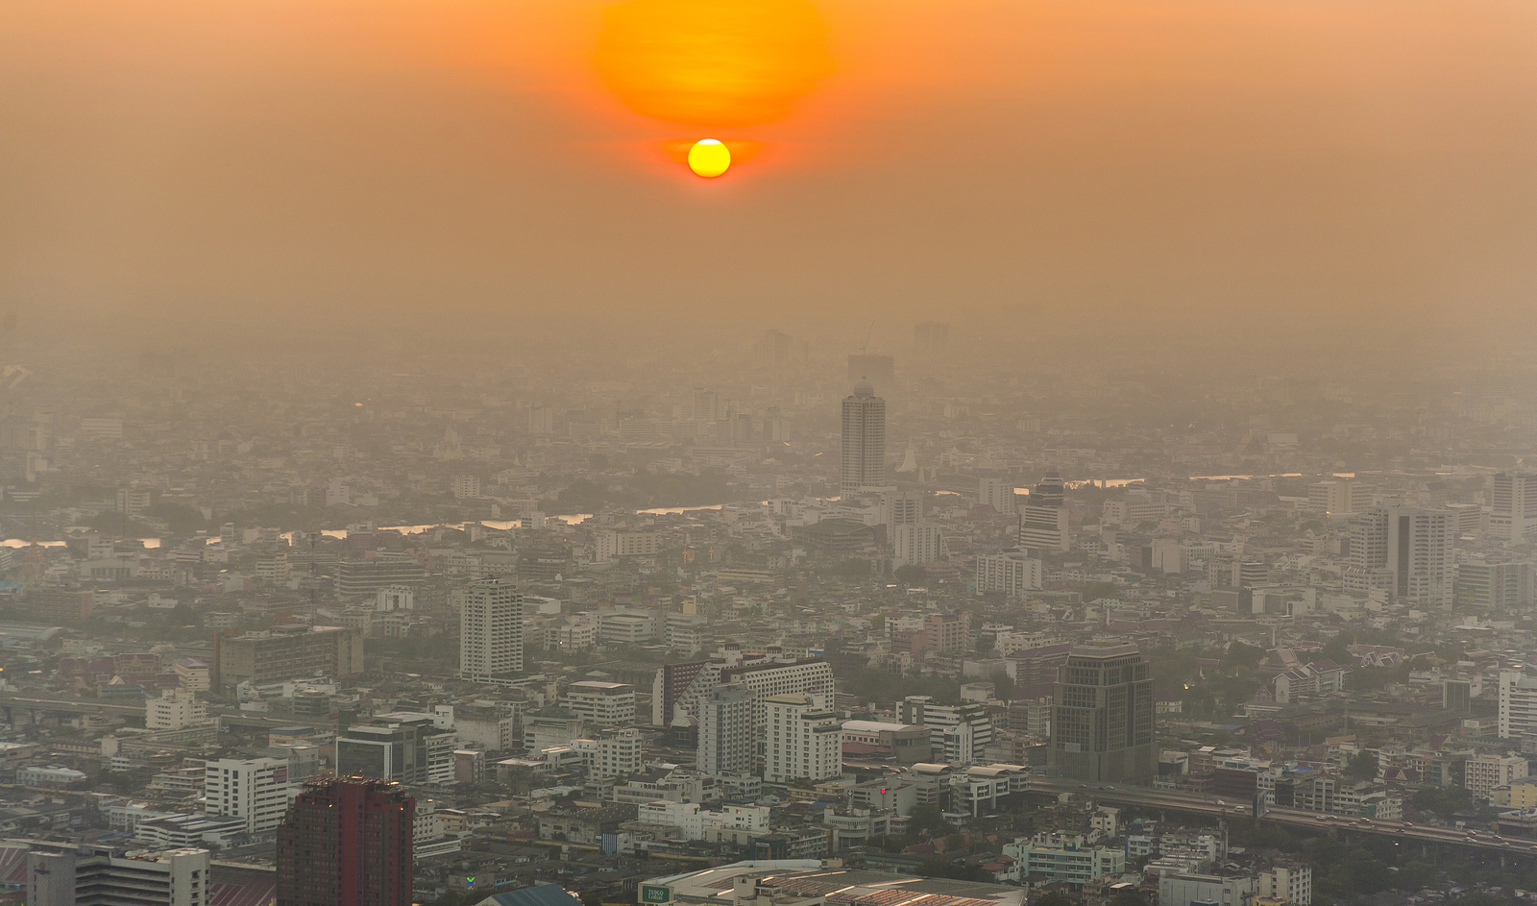
Outdoor air pollution
Robert G. Hendrickson, MD
Oregon Poison Center
Oregon Health and Science University
Portland, Oregon, USA

Slide 2
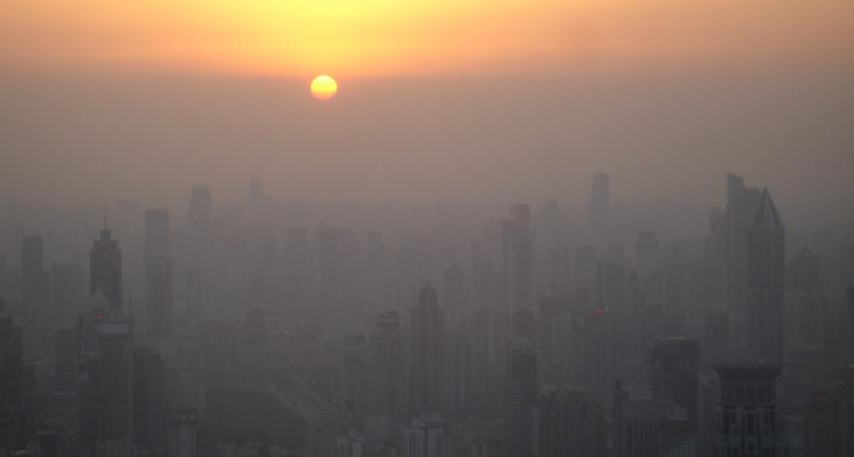
Outdoor air pollution
What is outdoor air pollution?
  Gases & fine particles produced from natural and man-made activities
  Smog = used to describe mixture of smoke/pollution and fog

Slide 3
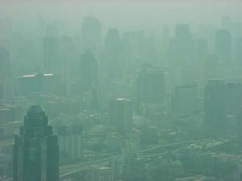
Bangkok

Slide 4
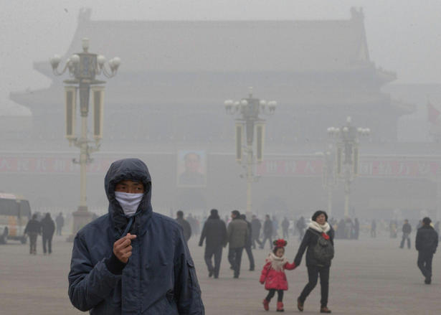
Beijing

Slide 5
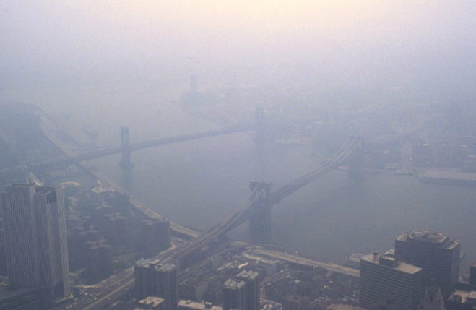
New York City

Slide 6
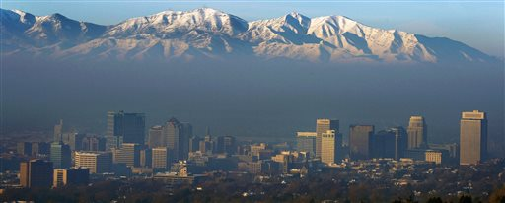
Salt Lake City, UT

Slide 7
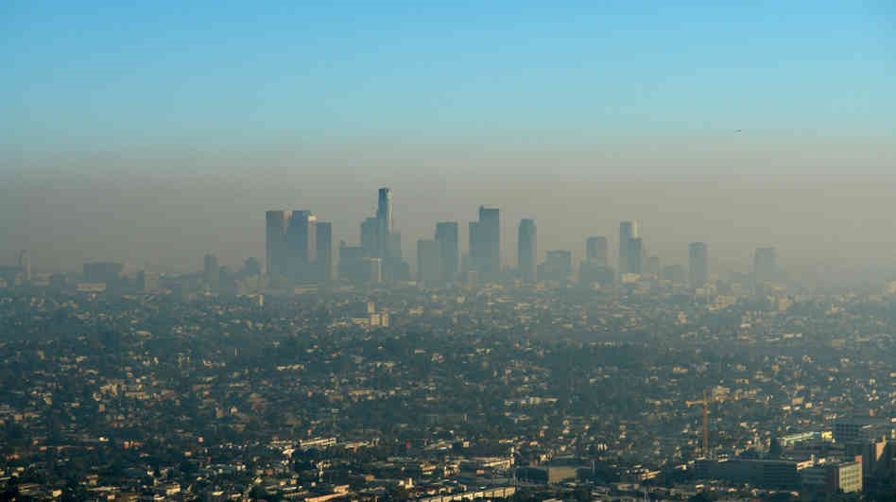
Los Angeles

Slide 8
Outdoor air pollution
What is outdoor air pollution?
  Oxides of nitrogen (e.g. nitrogen dioxide, NO₂)
  Sulfur dioxide (SO₂)
  Ozone (O₃)
  Carbon monoxide (CO)
  Particulate matter (PMs)
  Lead, metals, and other hazardous air pollutants (HAPs) or “air toxics”

Slide 9
Primary pollutants
Sulfur dioxide
Nitrogen dioxide
Carbon monoxide
Volatile organic compounds (VOCs)
Hazardous air pollutants (HAPs)(e.g. lead, etc)
Notes:
VOCs – released from burning fuel. Some examples: formaldehyde, benzene, toluene, styrene, xylene, perchloroethylene.

Slide 10
Secondary pollutants
Pollutants that are formed from chemical or photochemical reactions of primary pollutants
  Ozone (VOCs + NO_{x} -> ozone)
  Nitric acid (HNO₃)
  Formaldehyde
  Particulate nitrate (acid rain)
  Particulate sulfate (acid rain)

Slide 11
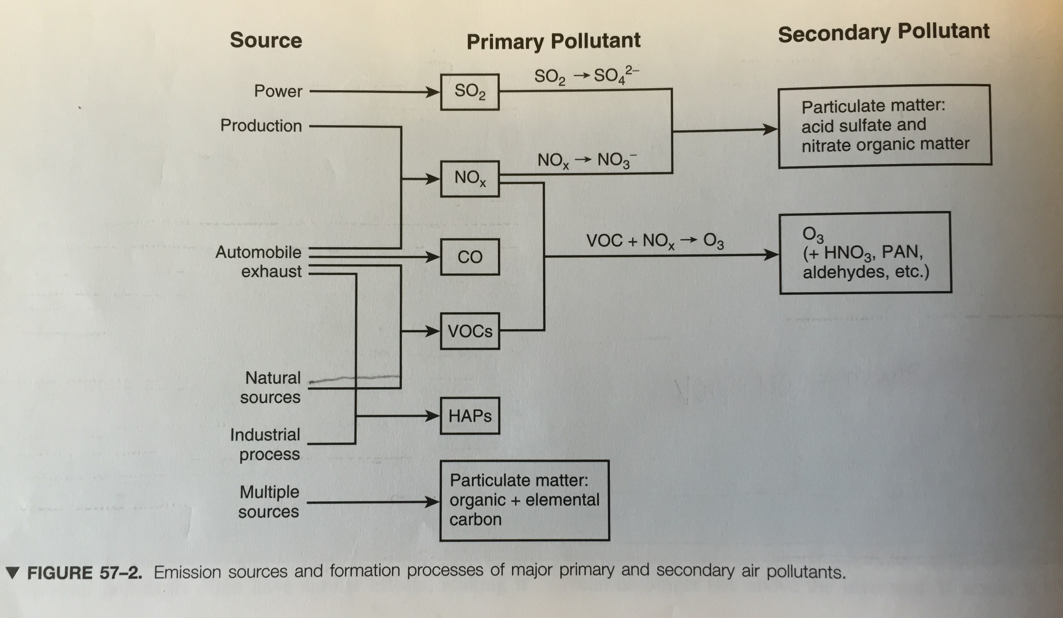
Greenberg MI, ed. Occupational, industrial, and environmental toxicology, 2nd edition. Mosby, 2003

Slide 12
Individual agents
Sulfur dioxide (SO₂)
Oxides of nitrogen (e.g. nitrogen dioxide, NO₂)
  Acid rain
Ozone (O₃)
Carbon monoxide (CO)
Particulate matter (PMs)
Lead, metals, and other hazardous air pollutants (HAPs) or “air toxics”

Slide 13
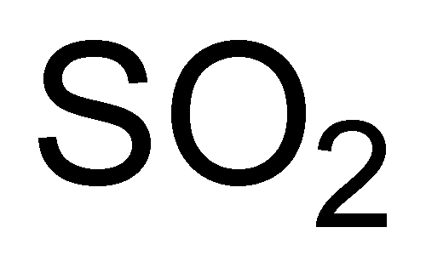
Sulfur dioxide
Primary source = coal power plants
Sulfur dioxide(SO₂) -> sulfuric acid (H₂SO₄)
  In atmosphere and in respiratory tract

Slide 14
Sulfur dioxide
Water soluble irritant gas
  Upper airway deposition
  Produces sulfurous acid, bisulfite, sulfite, and H₂SO₄
    Bronchoconstriction (bisulfite)
    Upper airway irritation
    Inflammatory/immune responses - sensitizer

Slide 15
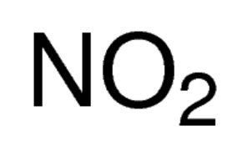
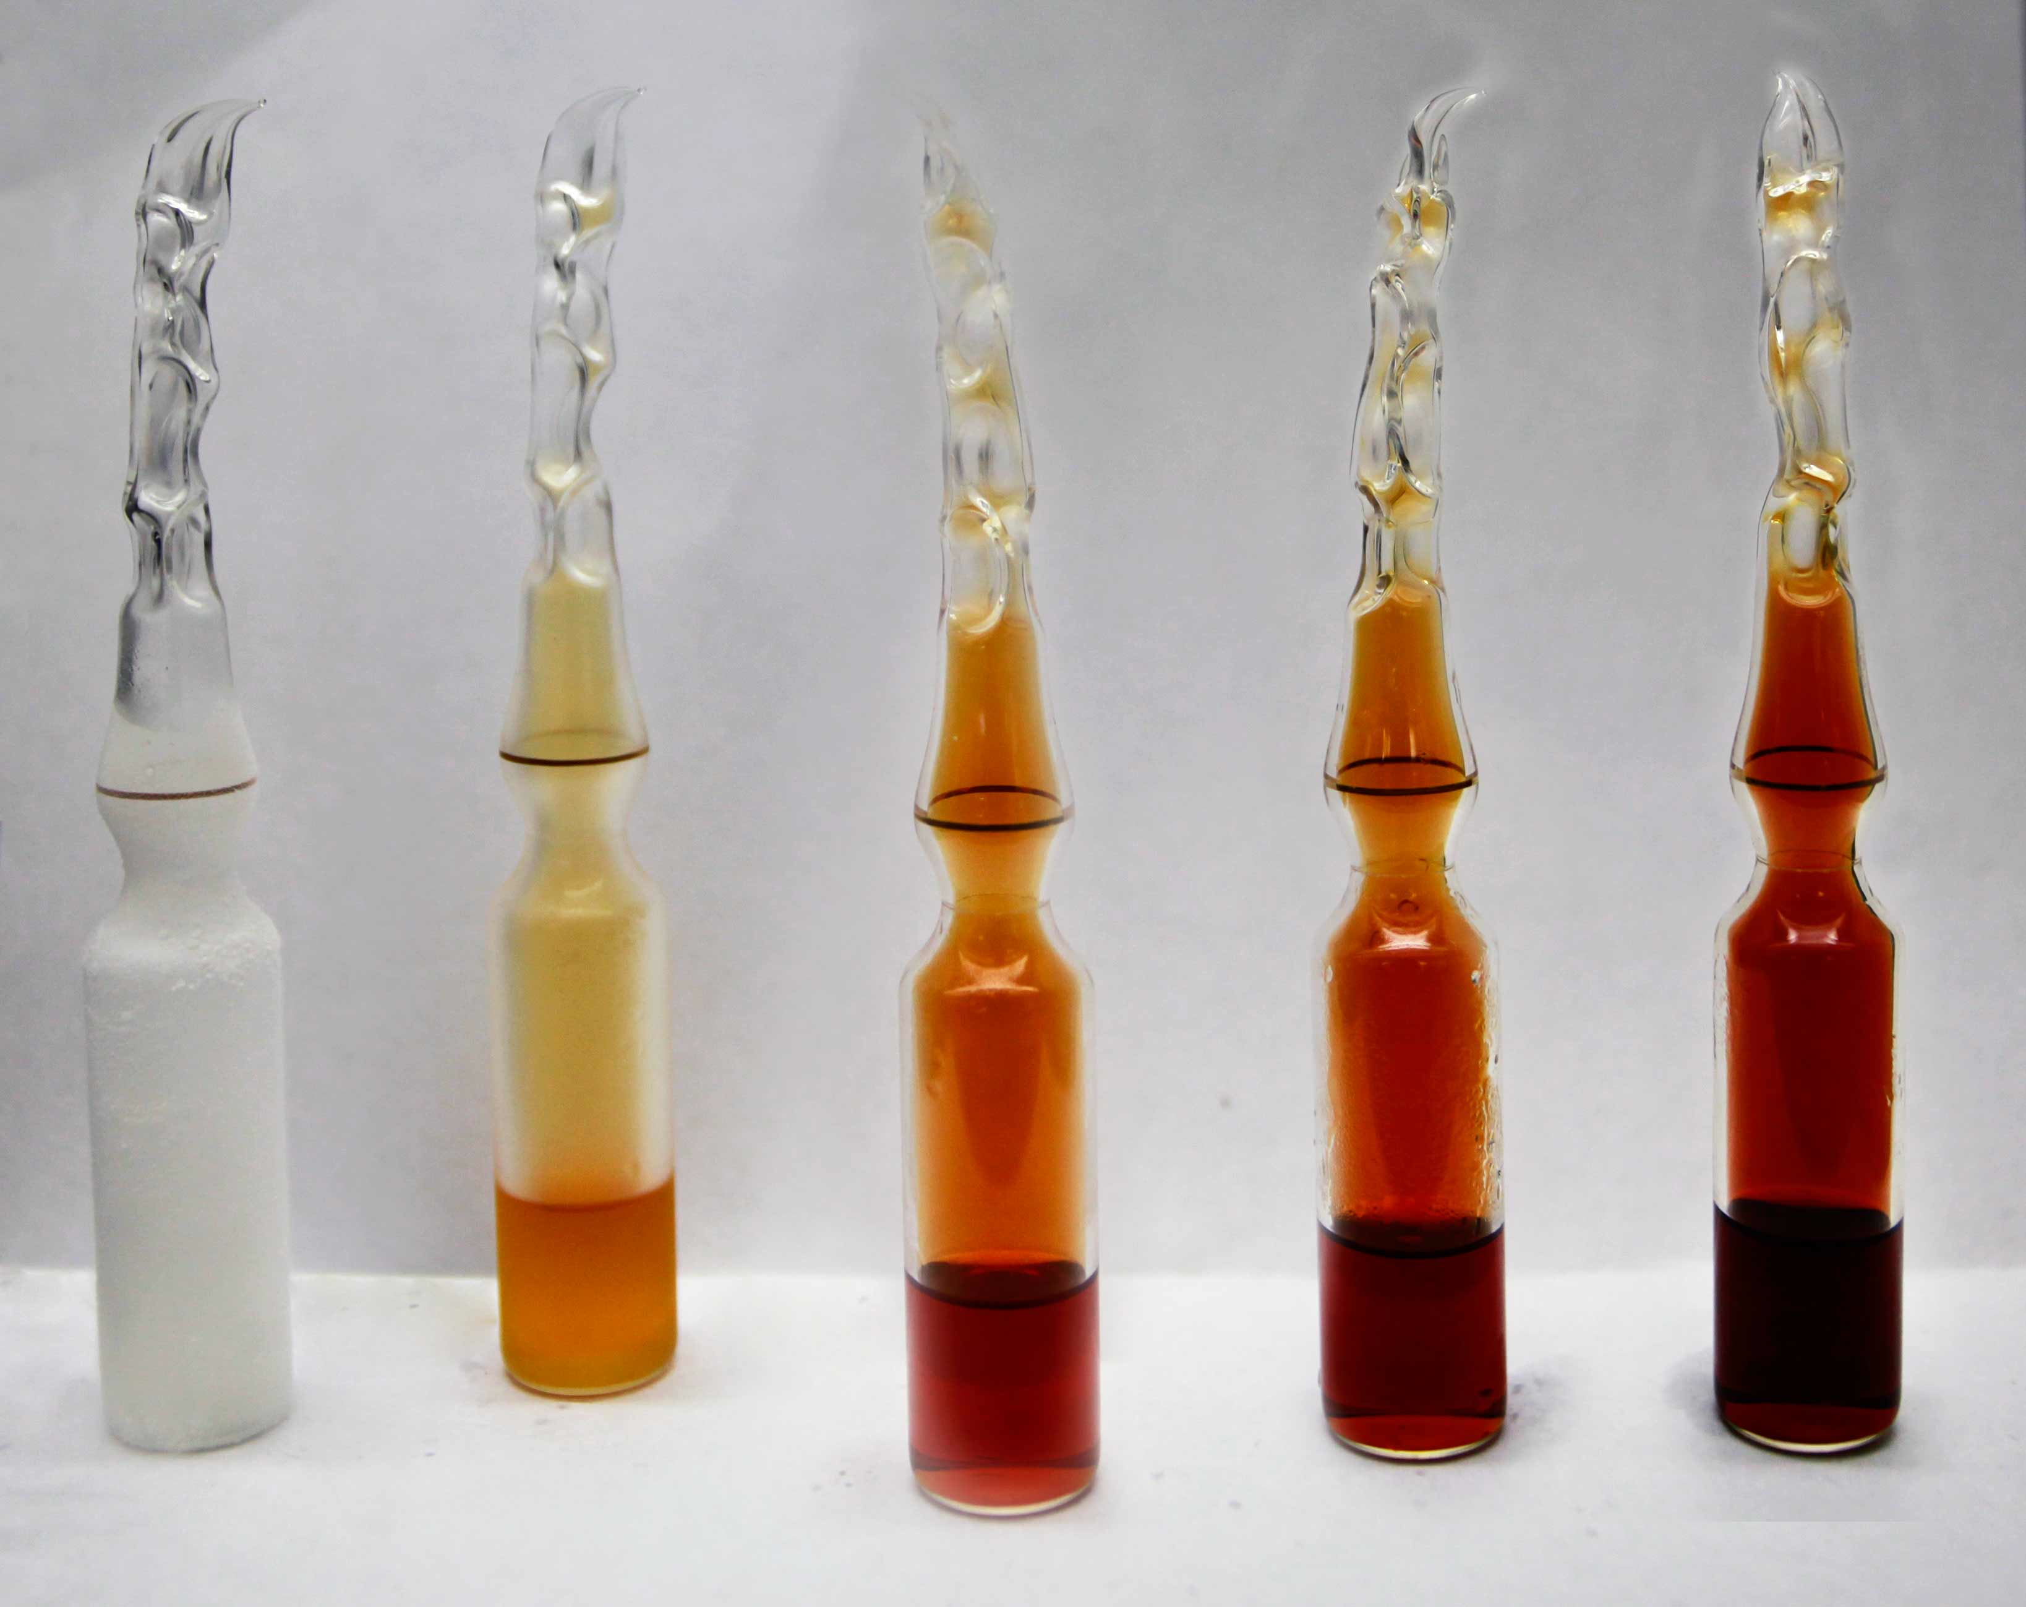
Nitrogen dioxide
Primary source is automobiles, then power generation, biomass burning(local)
N2 and O2 combine to form NOx
NO2(and PM) – give smog its red/brown color

Slide 16
Nitrogen dioxide
NO2 combines with water in lungs to form nitrous acid and nitric acid
  Bronchospasm/airway hyperresponsiveness
  Increased susceptibility to airway infections (chronic)

Slide 17
Ozone
Stratospheric (“good”) ozone
Ground-level (“bad”) ozone
  Created by reaction of NOx and VOCs and sunlight
    NOx released from energy production
    VOCs released from energy production, automobiles, and natural sources
      Ozone generally highest in afternoon w/ sunny weather (summer)

Slide 18
Ozone
Ground-level (“bad”) ozone
  Remains the most violated environmental standard in the United States
  Main component of smog

Slide 19
Ozone
Health effects:
  Low water solubility – alveoli
  Irritant and oxidant -> pulmonary inflammation
    Bronchospasm (cough, wheeze, chest tightness)
    Decreased FVC and FEV1

Slide 20
Ozone
Health effects:
  Short term:
    Increases in admissions for pneumonia, COPD, asthma, respiratory complaints
      Reversible (decreased asthma complaints in Atlanta, US after reduced traffic/ozone during Olympic games)
    Increased mortality rates on days with high ozone from cardiopulmonary disorders
  Long-term:
    Increased chronic respiratory illnesses (in lab animals)

Slide 21
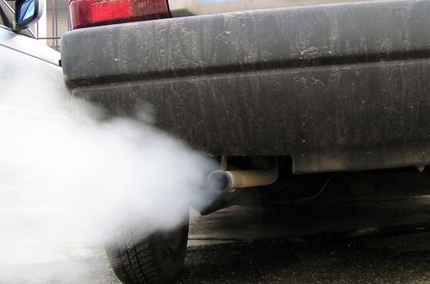
Carbon monoxide
Primary source = automobiles
Systemic effects:
  Decreases oxygen delivery
Acute toxicity
Chronic toxicity:
  Increased events in patients with chronic cardiopulmonary diseases: angina, MI.

Slide 22
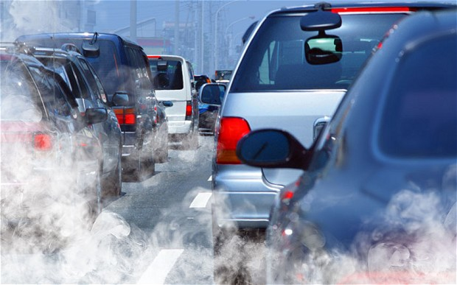
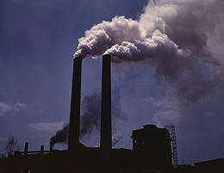
Particulate matter (PMs)
Solid and liquid components of airborne aerosol
  Acid sulfate and nitrates formed from SO₂ and NO_{x}
  Ammonium nitrate and sulfates
  Particulates from diesel exhaust, wood burning, dust, road surfaces, and elemental carbon

Slide 23
Particulate matter (PMs)
Large particles > 10 µm
  Deposit in upper airways
Coarse particles = 2.5-10 µm (PM10)
  Airborne dust, crustal elements (silicon, aluminum)
  Deposit in lower airways
Fine particles < 2.5 µm (PM2.5)
  Acid sulfates and nitrates
  Deposit in alveoli & have systemic effects
Total suspended particulates (TSP)

Slide 24
Particulate matter (PMs)
Health effects:
  PM10 associated with:
    Increases in asthma and COPD exacerbations

Slide 25
Particulate matter (PMs)
Health effects:
  PM2.5 associated with:
    Increased mortality
    PM2.5 concentration correlates with
      Increased histamine release in airways
      Reduced macrophage activity in lungs (decreased response to infection?)
      Decreased heart rate variability (marker for MI risk)
      Increased ICD discharges
      Increased plasma viscosity

Slide 26
Particulate matter (PMs)
Harvard Six Cities Study
For each 10µg/m3 increase in PM2.5:
  1.5% daily increase in mortality
  3.3% daily increase in COPD deaths
  2.1% daily increase in ischemic heart disease deaths

Slide 27
Hazardous air pollutants (HAPs)
US EPA introduced HAPs in 1997
189 chemicals
  VOCs
  Metals
  Important chemicals: benzene, arsenic, lead, mercury

Slide 28
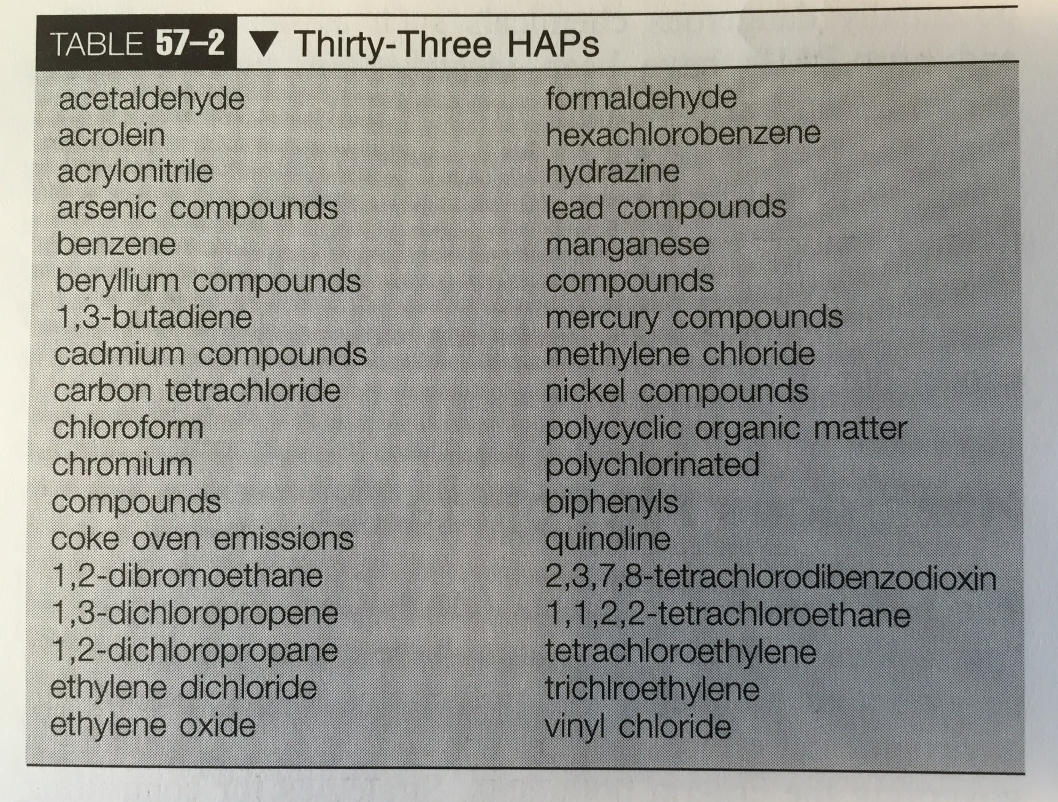
Hazardous air pollutants (HAPs)
33 HAPs that are “most hazardous to human health”

Slide 29
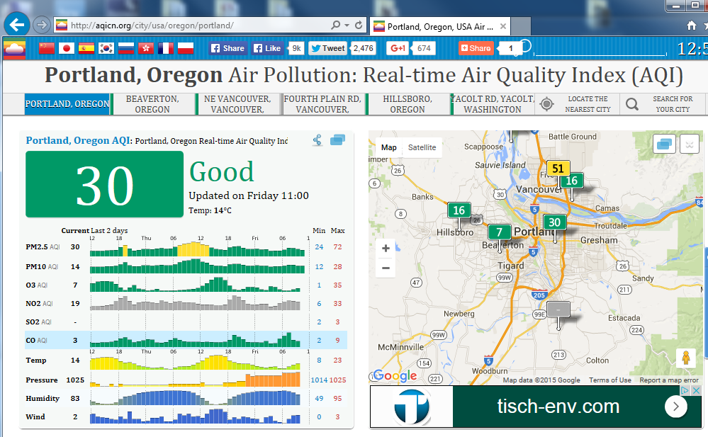
Patterns of air pollution
Natural peaks and valleys
  SO₂, CO – cold weather
  NO₂ - mid-day
  O₃ - mid-day, sunny weather (summer)
Notes:
SO2 = coal powered plants – more when it is cold
NO2 = automobiles – more while cars are on the road

Slide 30
Air Quality Index
0-500
100 = PEL
AQI = the highest AQI number for any of the pollutants
Non-linear

Slide 31
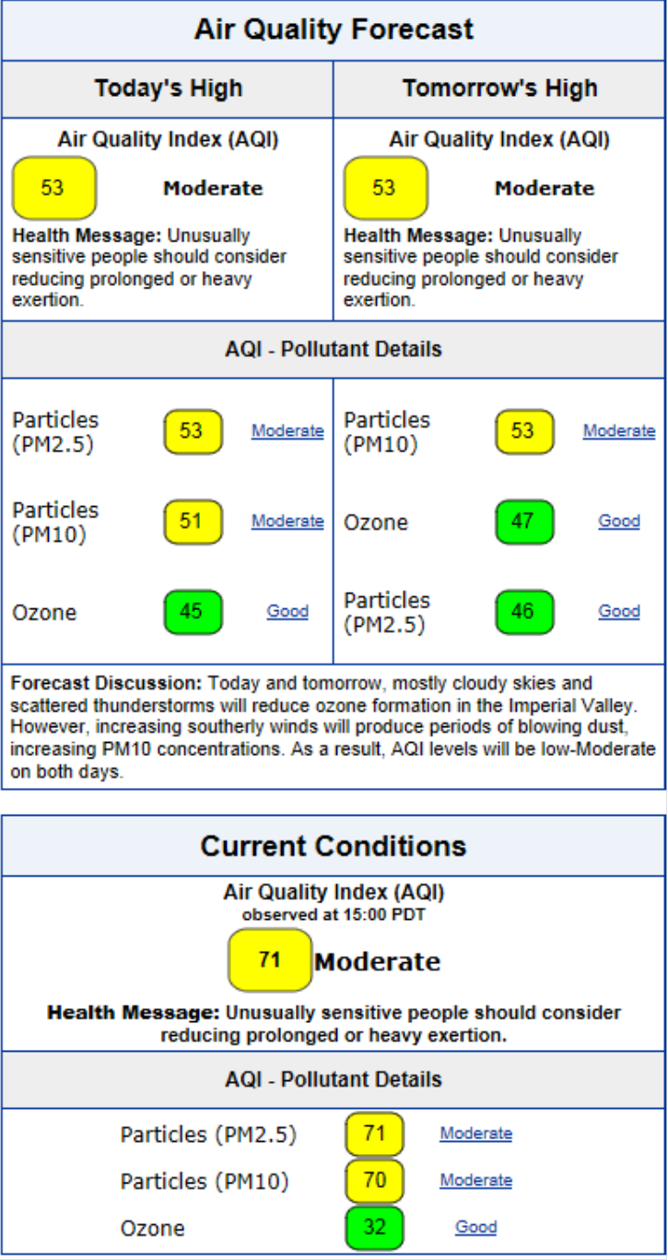
Air Quality Index
0-500
Notes:
53 = air quality is acceptable, but a small # of people may have increased pulmonary complaints

Slide 32
US Regulation
1955, Air Pollution Control Act
1965 Motor Vehicle Air Pollution Control Act
1963 Clean Air Act
  Amended 1970, 1977, 1990

Slide 33
Clean Air Act
Established National Ambient Air Quality Standards (NAAQS) to protect public health
  US EPA responsible for establishing and revising
    If a county is designated as a nonattainment area, then the state is mandated to develop a plan to bring the county into attainment
    States also issue permits for large stationary sources of criteria pollutants

Slide 34
National Ambient Air Quality Standards
Pollutant | Time | Thai NAAQS | US NAAQS | WHO
PM2.5 | 24h 1year | - - | 35 mcg/m³ 15 mcg/m³ | 25 mcg/m³ 10 mcg/m³
PM10 | 24 h 1 year | 120 mcg/m³ 50 mcg/m³ | 150 mcg/m³ | 50 mcg/m³ 20 mcg/m³
Pb | 1 month 1 year | 1.5 mcg/m³ | 0.15 mcg/m³ (quarterly) | 0.5 mcg/m³
SO2 | 1 hour 24 hour 1 year | 780 mcg/m³ 300 mcg/m³ 100 mcg/m³ | 197 mcg/m³ | 20 mcg/m³
NO2 | 1 hour 1 year | 320 mcg/m³ | 188 mcg/m³ 100 mcg/m³ | 200 mcg/m³ 40 mcg/m³
Ozone | 1 hour 8 hours | 200 mcg/m³ 140 mcg/m³ | 140 mcg/m³ | 100 mcg/m³
CO | 1 hour 8 hours | 34.2 ppm 10.3 ppm | 35 ppm 9 ppm | 30 ppm 10 ppm

Slide 35
Clean Air Act
Determined “criteria pollutants”:
  NO₂, SO₂, CO, O₃, Lead, PM2.5, PM10
1990 Clear Air Act amendment
  189 additional pollutants (“hazardous air pollutants”, HAPs)
    33 posing the greatest threat to public health
    Phase 1:
      Maximum achievable control technology (MACT)
      Determined by EPA
      Required for all sources of HAPs

Slide 36
Aqicn.org
http://www.deq.state.or.us/aqi/index.aspx

Slide 37
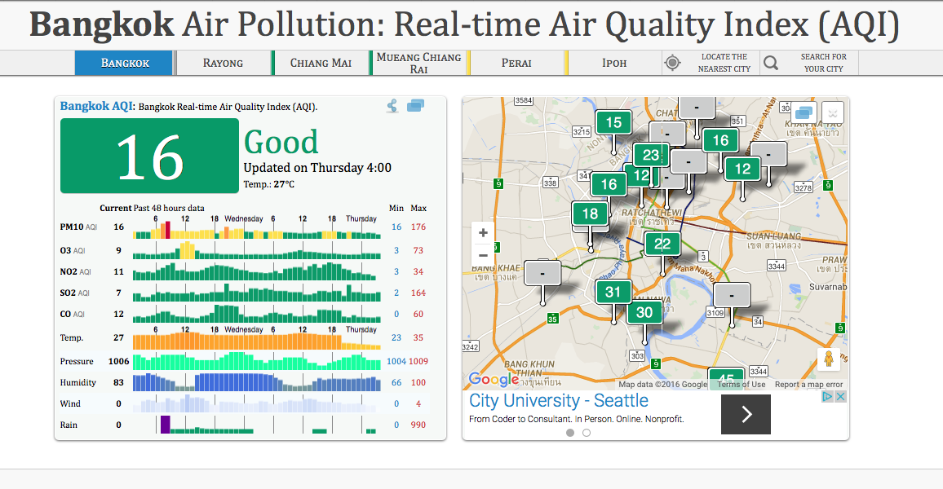
Bangkok, Thailand

Slide 38
Conclusions
Air pollution:
  Is a complicated mixture of primary pollutant as well as secondary pollutants
  May lead to increases in respiratory complaints/infections as well as increased mortality from respiratory and cardiovascular illnesses
  May be controlled by strict regulation of source polluters and vehicles
  Is monitored in real-time in many locations

Slide 39

Questions?

Slide 40
Has regulation worked?

Slide 41
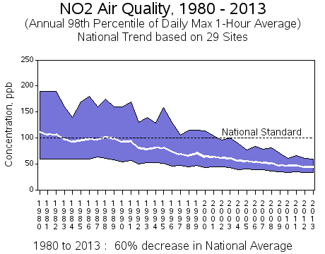
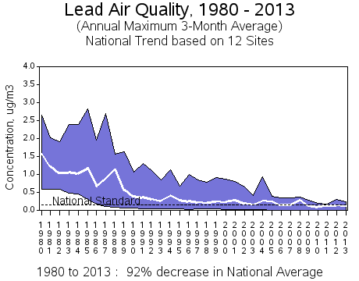
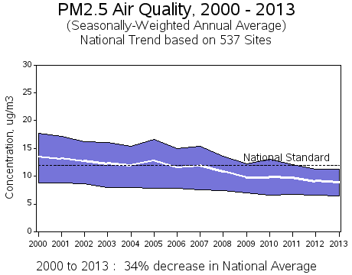
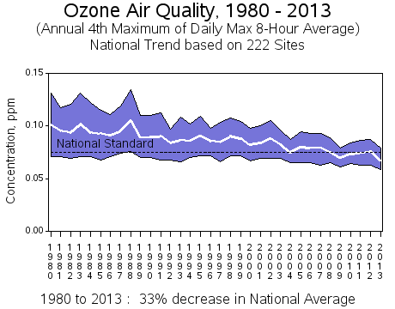
Nitrogen dioxide
PM2.5

Slide 42
Effective controls for outdoor air pollution
Regulation of coal-fired energy production and fixed site polluters (HAPs)
  Reduced sulfur coal (and gas and diesel)
  Engineering controls at energy production facilities
    Catalytic converters for smoke stacks
    Finding alternative raw materials or catalysts
Notes:
Thai automobile emissions standards 1995

Slide 43
Effective controls for outdoor air pollution
Regulation of automobile pollution:
  Fuel reformulation:
    Leaded gas discontinued (1996, Thailand)
    Decrease benzene content to <3.5%
    Increased oxygen content (MTBE, ethanol)
    Diesel and gasoline sulfur reduction
  Automobile emission standards (1995, Thailand)
Notes:
Thai automobile emissions standards 1995
Leaded gas discontinued in 1996

Slide 44
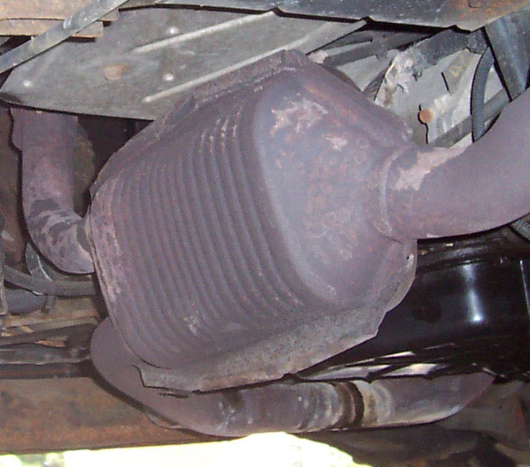
Effective controls for outdoor air pollution
Catalytic converters (1975)
  Catalyze redox reactions
    Combine CO w/ O₂ to form CO₂
    Oxidize unburned hydrocarbons to form CO₂ and H₂O
    “Three-way” CC also reduce NO_{x} to N₂ and O₂

Slide 45
Sulfur dioxide and nitrogen dioxide
Non-medical, environmental effects

Slide 46
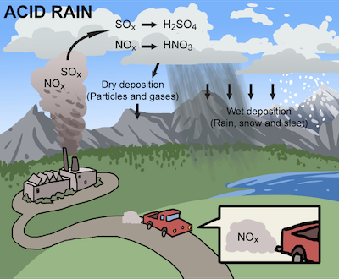
Acid Rain
Sulfuric acid
Nitric acid
Notes:
Sulfuric acid and nitric acid
pH can be as low as 5 in NE US.

Slide 47
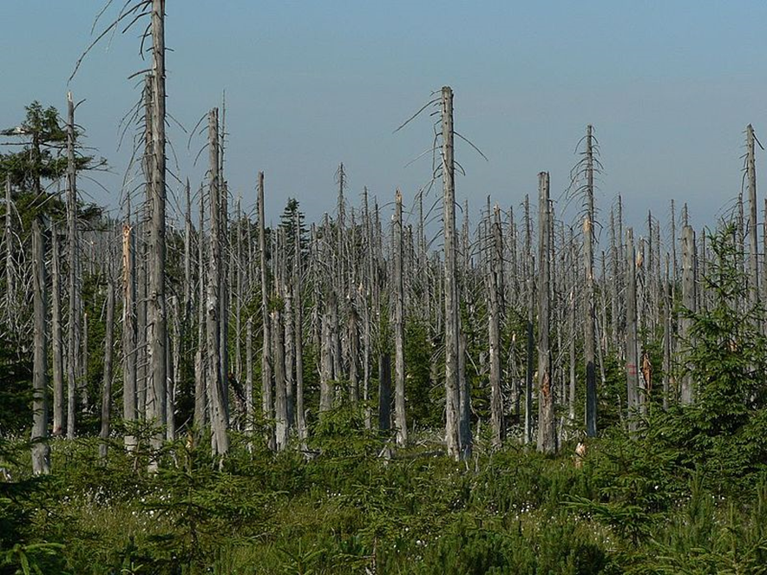
Acid rain

Slide 48

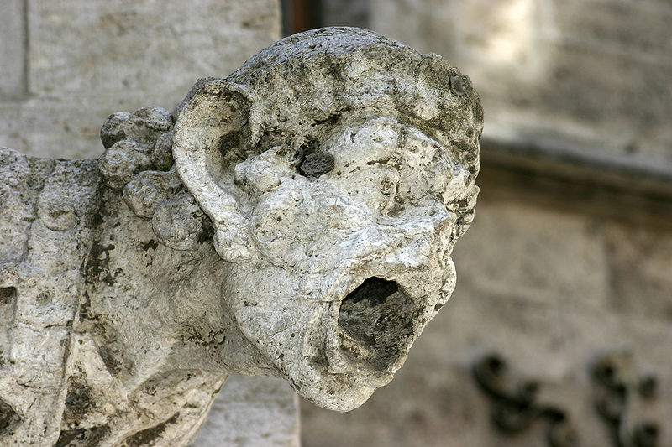
Acid rain

Slide 49
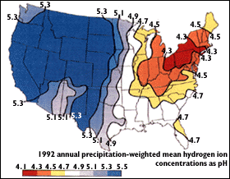
Acid rain

